Slide 1


McDowell EcoLabs
Champaign County Bike Crash
Supanut Wanchai
wanchai2

Slide 2

Outline
Motivation & Introduction
Data Pre-processing
Data Analysis & Hypothesis Testing
Conclusion

Slide 3

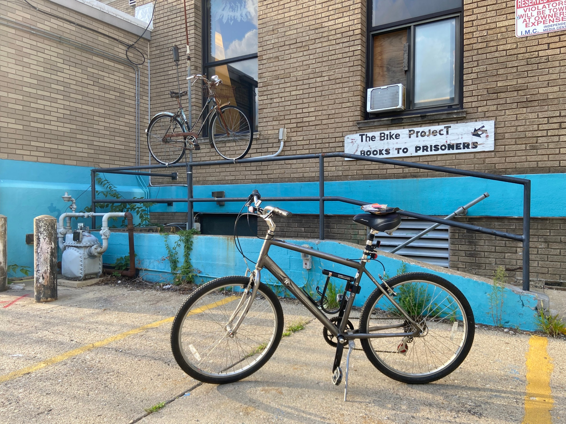
Motivation

Slide 4
National Bike Crash
Overall, decline in Bike accident
Significant increase in Fatal Accident
Source: National Safety Council https://injuryfacts.nsc.org/

Slide 5
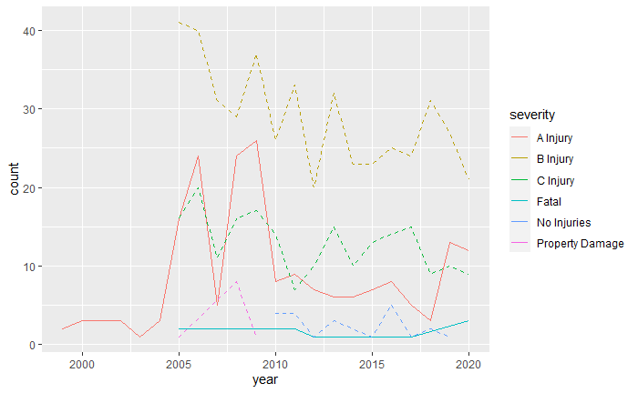
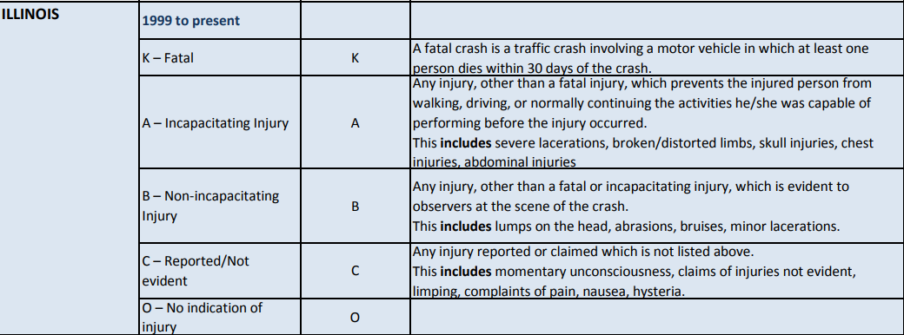
Champaign Bike Crash
Severe injure and Fatal likely to increase
What lead to severe bike crash?

Slide 6
Data Preprocessing
Bike Data from 1999-2020
Highlight Variables
911 rows --exclude before 2005 -> 896 rows
-- exclude Unknown -> 833 rows
Severity
Weather
Light
Road Surface
Traffic Control
City
Pedestrian Data from 1999-2020
825 rows --exclude before 2005 -> 799 rows
-- exclude Unknown -> 743 rows

Slide 7
Data Grouping
 | Severity
Severe | Fatal, A-Injury
Non-Severe | B-Injury, C-Injury, No Injuries, Property Damage
 | Weather | Light | Road Surface | Traffic Control | City
Good Condition/ City Area | Clear | Daylight, Lighted Road | Dry | Any Control | Any City
Bad Condition/ Unincorporated Area | Cloudy/Outcast, Fog/Smoke/Haze, Rain, Snow | Dawn, Dusk, Darkness | Ice, Sand/Mud/Dirt, Snow or Slush, Wet, Other | No Control | Unincorporated

Slide 8
Bike Contingency Table & Odds Ratio
Weather | Severe | Non-Severe
Bad | 21 | 67
Good | 165 | 580
Odds Ratio/ 95% CI | 1.10 | [0.62, 1.87]
Traffic Control | Severe | Non-Severe
Bad | 80 | 250
Good | 106 | 397
Odds Ratio/ 95% CI | 1.20 | [0.84, 1.69]
Light | Severe | Non-Severe
Bad | 20 | 52
Good | 166 | 595
Odds Ratio/ 95% CI | 1.38 | [0.76, 2.43]
City | Severe | Non-Severe
Unincorporated | 21 | 35
City Area | 165 | 612
Odds Ratio/ 95% CI | 2.22 | [1.19, 4.05]
Road Surface | Severe | Non-Severe
Bad | 23 | 69
Good | 163 | 578
Odds Ratio/ 95% CI | 1.18 | [0.68, 1.99]

Slide 9
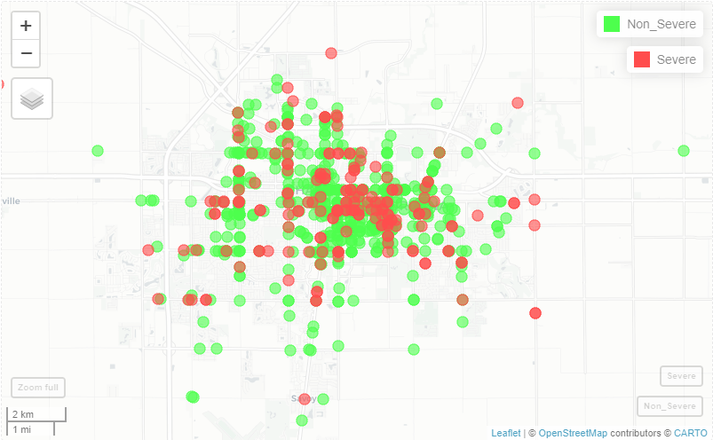
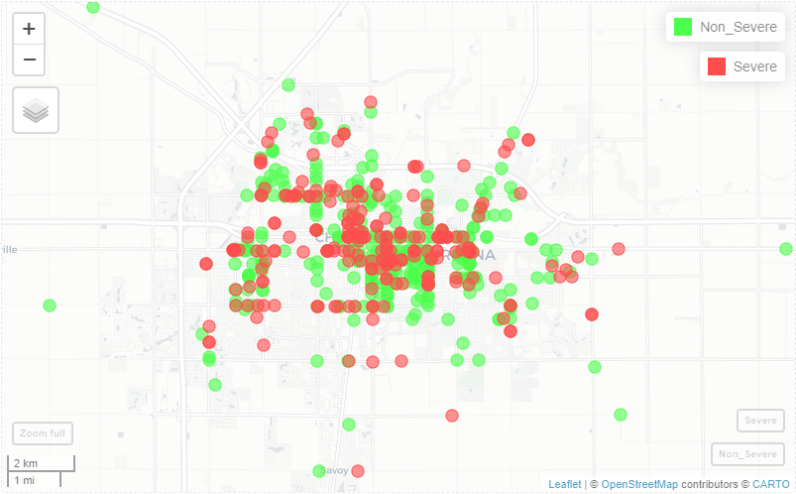
Bike vs Pedestrian Crash Map
Bike Crash
Pedestrian Crash

Slide 10
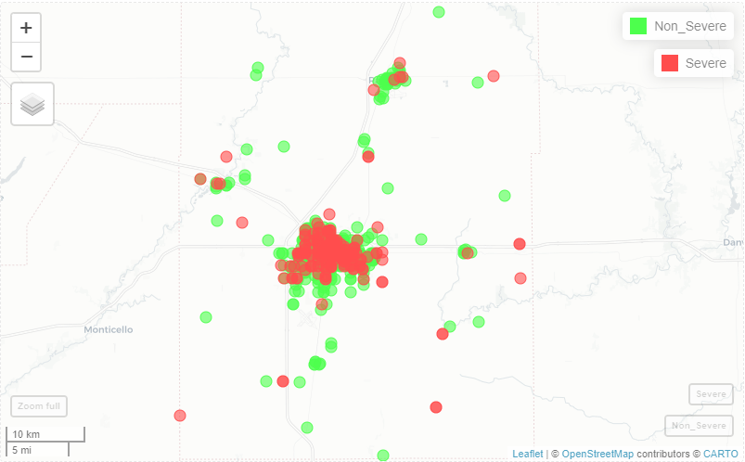
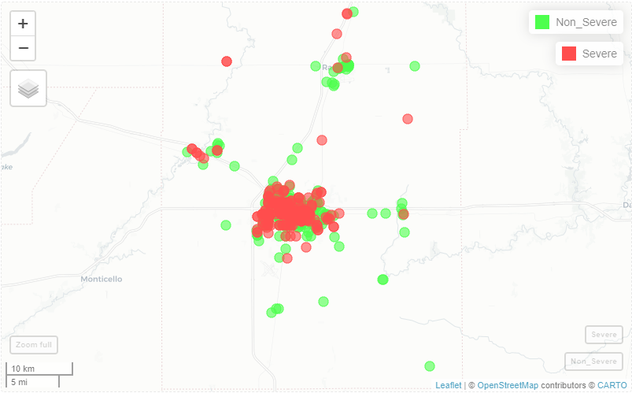
Bike vs Pedestrian Crash Map
Bike Crash
Pedestrian Crash

Slide 11
Pedestrian Contingency Table & Odds Ratio
Weather | Severe | Non-Severe
Bad | 43 | 86
Good | 229 | 385
Odds Ratio/ 95% CI | 0.84 | [0.55, 1.27]
Traffic Control | Severe | Non-Severe
Bad | 143 | 218
Good | 129 | 253
Odds Ratio/ 95% CI | 1.29 | [0.94, 1.75]
Light | Severe | Non-Severe
Bad | 62 | 74
Good | 210 | 397
Odds Ratio/ 95% CI | 1.58 | [1.07, 2.35]
City | Severe | Non-Severe
Unincorporated | 18 | 26
City Area | 254 | 445
Odds Ratio/ 95% CI | 1.21 | [0.61, 2.35]
Road Surface | Severe | Non-Severe
Bad | 61 | 97
Good | 211 | 374
Odds Ratio/ 95% CI | 1.11 | [0.76, 1.62]

Slide 12

Summary
What’s next?
Severe bike crash statistically happened more frequently in unincorporated area.
Light condition is statistically significant for pedestrian crash severity, so avoid walking in dark area.
Where is the safest area to go cycling?
Does traffic crime affect crash severity?

Slide 13
Thank you for listening

